Slide 1
LECTURE 2
Building the First
Predictive Model
Practical Machine Learning for Transcriptomics in Cancer Research
From a clean dataset to a baseline you can defend.
Yinxiu Zhan· IEO/UNIMI · 2026
Notes:
Goal: build first model; why baseline is important (good vs bad)

Slide 2
RECAP
Where we are
Last time: framed the clinical question, met the data matrix, p ≫ n, batch effects, leakage, and the split discipline.
We left with a clean, split, leak-aware METABRIC dataset and deliberately built no model.
Today: the first complete pipeline, and a model we can actually trust.
Through-line: a trustworthy biomarker (our aim for today) matters more than a sophisticated algorithm.
Biological question → ML problem
✓
Building the first model
2
Feature engineering & representation
3
Improving & validating models
4
Research-grade ML
5
Practical ML for Transcriptomics · Lecture 2
2
Notes:
Describe 1. 2, 3 (using the workflow briefly described yesterday). 4

Slide 3
ROADMAP
Learning objectives
Understand the structure of an ML pipeline
Distinguish train / validation / test; cross-validation
□
□
Explain the role of preprocessing
Evaluate with the right classification metrics
□
□
Understand Logistic Regression conceptually
Recognise overfitting: the default in p ≫ n
□
□
Understand regularisation (LASSO, Elastic Net)
Interpret coefficients; know why a baseline is essential
□
□
Practical ML for Transcriptomics · Lecture 2
3
Notes:
Describe the objectives. Which is the most difficult here in your opinion and the most critical part?

Slide 4
PART 1 · THE PIPELINE
The machine learning pipeline
Data
Preprocessing
Model
Prediction
Evaluation
fit on TRAIN only — preprocessing & model live inside the wall
Five stages — and the model is only one of them.
Every stage is a decision point; most failures happen outside the model box.
Preprocessing and fitting must happen within train-only.
Today we walk the pipeline end to end on METABRIC.
Practical ML for Transcriptomics · Lecture 2
4
Notes:
Title -> description of the pipeline quickly -> describe now the 4 points

Slide 5
PART 1 · THE PIPELINE
What “training a model” actually means
A model is a function from gene-expression features (X) to a predicted probability of recurrence.
“Training” = choosing the function’s parameters so its predictions fit the training data.
“Prediction” = applying the frozen function to new patients.
The recurring danger: a function flexible enough to memorise training patients.
How to prevent overfitting: simpler function, validation, regularisation
fit on train only
X
(genes)
model
P(recurrence)
Practical ML for Transcriptomics · Lecture 2
5
Notes:
Let’s start with training. Title -> 1 -> 2 -> 3 -> 4 ->5 (we will cover these in this lecture)
Remember training does not mean finding the true function, it means finding a proxy that fits this particular sample. Whether it captures biology, we do not know until we interpret it and validate it using causal inference methods.

Slide 6
PART 1 · THE PIPELINE
The task today, restated
Input: a patient’s expression profile (the wide X from Lecture 1).
Output: probability of recurrence within the horizon (binary y).
Train on the training split, tune on validation, do not touch the test set until the end.
Callback — a choice we made on purpose (Lecture 1)
This binary label is a deliberate simplification of time-to-event data. It discards timing (an 11-month and a 110-month relapse look identical) and forces censoring decisions.
Practical ML for Transcriptomics · Lecture 2
6
Notes:
Title -> 1 ->2 ->3 -> box

Slide 7
PART 2 · PREPROCESSING
Why preprocess at all?
Raw expression isn’t model-ready: genes live on different scales.
A model can be misled by scale alone: a high-variance gene can dominate model optimization for no biological reason.
Different batches carry technical variation
Missing values
Preprocessing makes features comparable and well-behaved, without injecting outcome information.
Every preprocessing statistic must be learned on training data only.
before
after standardising
genes on wildly different scales → comparable
Practical ML for Transcriptomics · Lecture 2
7
Notes:
The very first step is data exploration which include preprocessing -> title -> why not raw expression -> 1 -> 2 -> 3 -> 4 (e.g. different panels, different technologies, different version of gene annotation used for quantification) -> 5 -> comment the figure -> 6

Slide 8
PART 2 · PREPROCESSING
Preprocessing for microarray transcriptomics
1
Log transformation (or VST norm)
2
Standardisation (z-score)
Microarray intensities span orders of magnitude; log compresses the range and stabilises variance. REMEMBER: often already applied, check first.
Centre and scale each gene so coefficients and penalties are comparable across genes. WARNING: you lose relative information
3
Scaling ↔ regularisation
4
Missing values
Penalties assume features share a scale; scaling choices change which genes the penalty can “see”.
Inspect the pattern; impute inside the split (e.g. training-set medians) — never across train + test.
Practical ML for Transcriptomics · Lecture 2
8
Notes:
1→ log makes standisation better if dynamic range is very wild -> 2 -> 3 (we will see this) -> missing value imputation (because of different panels, for RNAseq, this can come from different gene annotation version)

Slide 9
PART 2 · PREPROCESSING
Preprocessing pitfalls: a leakage refresher
Standardising on the whole matrix before splitting = normalisation leakage.
Imputing with global means leaks; filtering genes by outcome-association on all samples is feature-selection leakage.
The fix is always the same: fit preprocessing on train, apply to validation / test.
A “pipeline” object enforces this for you.
Preprocessing steps that feels innocent, but contains data leakage: quantile normalization, filter low variance genes using all the samples!
WRONG — stats computed before the split
scale / impute / select on all samples → then split. The held-out data already shaped the model.
RIGHT — stats computed inside the fold
split first → fit preprocessing on train → apply to validation / test. Test touched once.
Practical ML for Transcriptomics · Lecture 2
9
Notes:
I keep repeating -> title -> 1 -> 2 ->3 -> sklearn pipeline or optuna -> 5 -> box

Slide 10
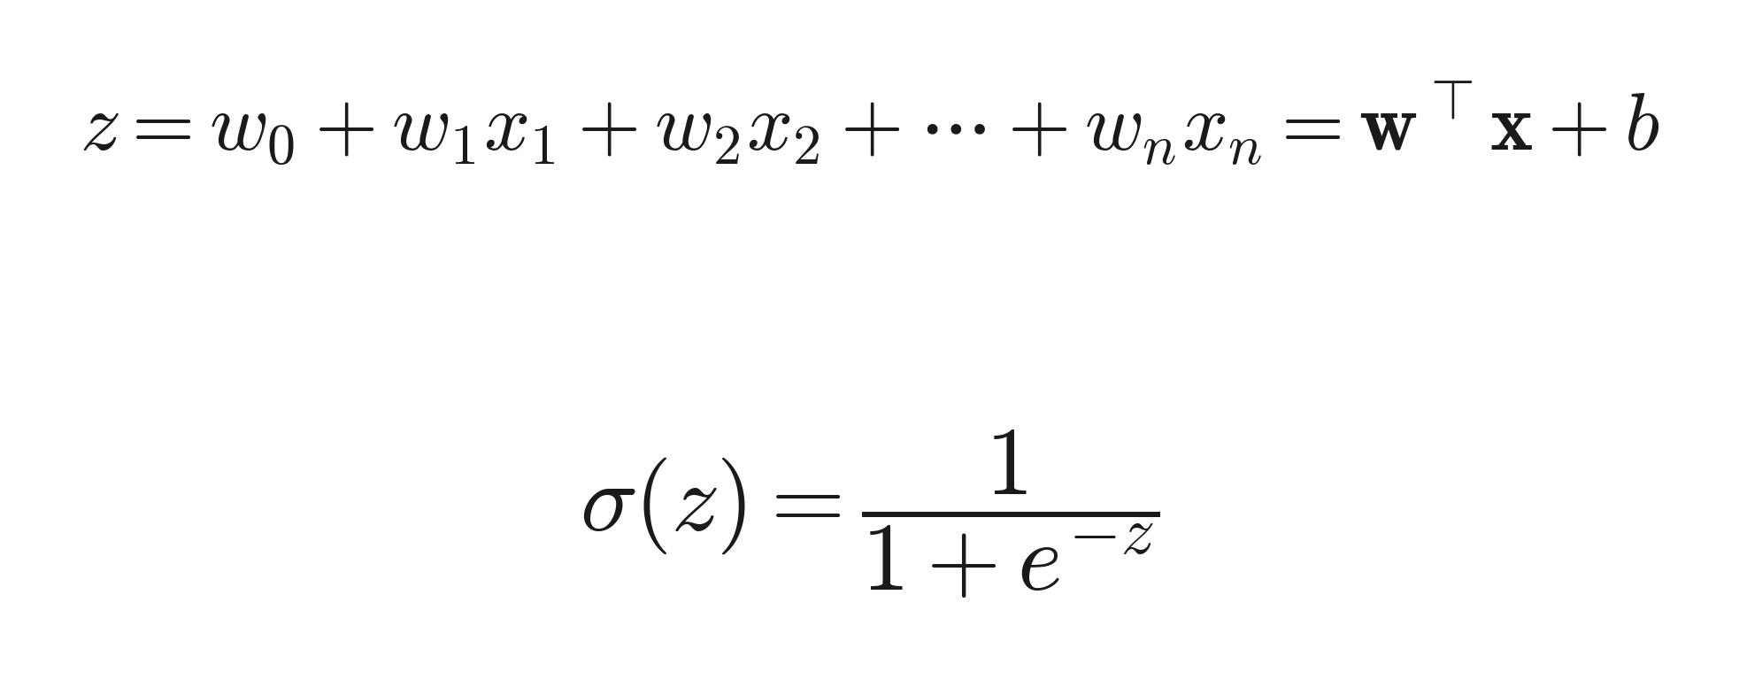
PART 3 · LOGISTIC REGRESSION
Logistic Regression
Takes linear combination of gene expression -> sigmoid function
Outputs a probability of recurrence between 0 and 1, then thresholds it into a class.
The model is uncertain around zero
Each gene gets a coefficient: positive pushes toward recurrence, negative away.
Interpretable, fast, and — crucially in p ≫ n — hard to overfit when regularised.
Very often, more complex model just leads to overfitting
Practical ML for Transcriptomics · Lecture 2
10
Notes:
Finally our first model -> logistic regression, simplest and linear -> 1 (describe sum -> produce score -> simoid function -> probability) -> 2 -> 3 (describe high score, low score and close to zero) -> 4 -> 5 ->6

Slide 11
PART 3 · LOGISTIC REGRESSION
The decision boundary, visually
With two genes, the boundary is a line; with thousands, a hyperplane we reason about.
One side predicts recurrence, the other no recurrence; near the line, the model is unsure.
The threshold (default 0.5) is a choice — we can move it to trade off the two error types.
THE WAY YOU MOVE IT DEPENDS ON WHAT IS WORSE: mislabelling recurrence or no recurrence
recurrence
↑ gene B
no recurrence
gene A →
Practical ML for Transcriptomics · Lecture 2
11
Notes:
Geometrically logistic regression -> 1 -> describe plot -> 2 -> 3 -> 4

Slide 12
PART 3 · LOGISTIC REGRESSION
Why Logistic Regression is a strong baseline
Interpretable: coefficients map to genes that clinicians and biologists can scrutinise.
Stable and fast: trains in seconds on thousands of genes, easy to cross-validate.
Often competitive: in p ≫ n with modest signal, simple linear models frequently match or beat complex ones.
The baseline is the important: any fancy model must beat a well-built Logistic Regression to justify itself.
+ deep learning
+ tree ensembles
Baseline: regularised LR
must be beaten to matter
Practical ML for Transcriptomics · Lecture 2
12
Notes:
Title -> 1 ( vs 1M params in deep learning or the trees) -> 2 ( fast = lots of cross validation we can do easily, you will see) -> 3 -> 4

Slide 13
PART 4 · REGULARISATION
Why we need regularisation
p ≫ n means a plain Logistic Regression can fit the training data perfectly, and generalise terribly.
Regularisation adds a penalty for large / numerous coefficients: it limits the model’s freedom.
Intuition: prefer the simplest explanation consistent with the data (fewer, smaller gene weights).
The single most important tool for making linear models work in transcriptomics.
Regularisation makes your models perform worse: the tiny improvement of performance might just be the overfitting, the memorisation
overfit (no penalty)
regularised
Practical ML for Transcriptomics · Lecture 2
13
Notes:
What is regularization -> title -> 1 (in 20k dimension an hyperplane can look like a squeeshy line) -> 2 -> 3 -> 4 -> 5 (worse is exactly the point, tradeoff between tiny gain in train, but lack of generalizability)

Slide 14
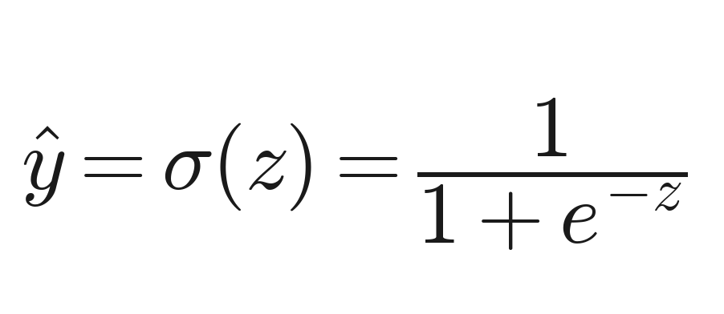
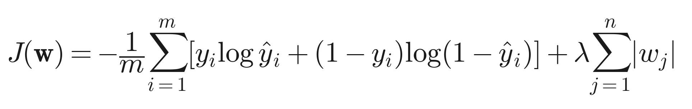
PART 4 · REGULARISATION
LASSO: sparse, feature-selecting models
survivors = selected panel
The LASSO penalty drives many coefficients exactly to zero: it selects a small gene panel automatically (feature extraction!)
Result: a sparse, interpretable signature — attractive for a candidate biomarker.
Caveat: among correlated genes, LASSO keeps one and drops the rest, thus selection is unstable.
So a LASSO panel is a hypothesis, not a proven causal gene set: DO NOT OVERINTERPRET LASSO GENES
Coeff
many genes → exactly 0
stronger penalty → · coefficients → 0
14
Practical ML for Transcriptomics · Lecture 2
Notes:
First is lasso regularization. It is also called a feature extraction method and we will see why briefly now and recall it tomorrow.
Describe the formula -> 1 -> plot -> 2 -> 3 -> 4

Slide 15
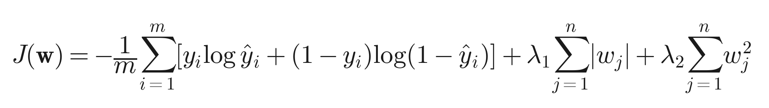
PART 4 · REGULARISATION
Elastic Net: handling correlated genes
correlated gene cluster
correlated gene cluster
Genes work in pathways — they are highly correlated, exactly the case LASSO handles poorly.
Elastic Net blends two penalties: it can keep groups of correlated genes together, improving stability.
More robust signatures under resampling — directly addressing Lecture 1’s “signatures are not unique”.
A sensible default baseline for transcriptomics: Logistic Regression + Elastic Net.
LASSO — keeps one
Elastic Net — keeps the group
Practical ML for Transcriptomics · Lecture 2
15
Notes:
How to deal with correlated genes? 1 -> 2 -> describe formula -> 3 -> 4
Why it keeps all genes? Because derivative of w^2 is w, meaning that when we are close to zero, lambda2 becomes negligible.
Example: proliferation score is made of 5 genes -> lasso keeps 1 -> elastic net can keep all five. The drawback is that the importancy is split across genes.

Slide 16
PART 5 · EVALUATION
Evaluating a classifier: accuracy is not enough
Recurrence is a minority class: accuracy is misleading.
A model that predicts “no recurrence” for everyone can score high accuracy and be useless.
We need metrics that respect which errors we make, not just how many.
Practical ML for Transcriptomics · Lecture 2
16
Notes:
Evaluation: this is critical -> it tells us when model is good or bad ->title -> describe accuracy -> 1 -> 2 -> plot -> 3

Slide 17
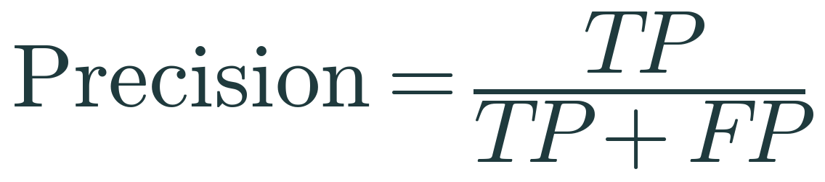
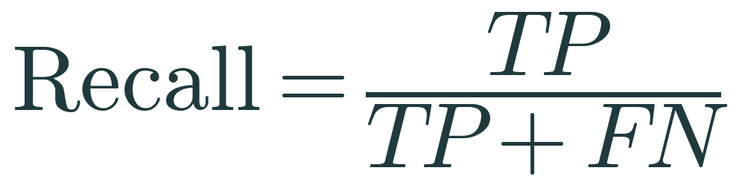
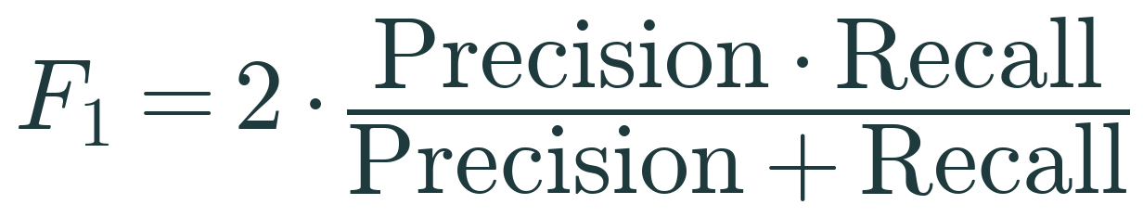
PART 5 · EVALUATION
The confusion matrix and the metrics it yields
Precision: of predicted recurrences, how many were real (don’t over-flag).
Recall / sensitivity: of real recurrences, how many we caught (don’t miss a relapser).
F1: the balance of the two.
Which to prioritise depends on the clinical cost asymmetry.
If you want to minimize the missed recurrence, maximise recall.
If you want to minimize over treatment, maximize precision
predicted →
True Positive
False Positive
caught a real recurrence
false alarm (over-treat)
actual ↓
False Negative
True Negative
missed a recurrence
correctly cleared
Practical ML for Transcriptomics · Lecture 2
17
Notes:
Solution -> confusion matrix -> describe the plot -> 1 -> 2 -> 3 -> 4 -> 5 ->6 -> 7

Slide 18
PART 5 · EVALUATION
ROC-AUC and PR-AUC
ROC-AUC: ranking quality across thresholds; 0.5 chance, 1.0 perfect: but it is optimistic under imbalance.
PR-AUC: precision vs recall; far more informative when the positive class is rare.
Report both; choose the operating threshold deliberately, not by default.
Which to use depends on the trade-off between errors on false positive or negative
Practical ML for Transcriptomics · Lecture 2
18
Notes:
Two other metrics that are very used -> it’s threshold independent. -> 1 ROC (receiver operating characteristic). -> probability of recurrer above not-recurrer -> since it does not account for false negatives, it might be optimistic for imbalanced dataset (high rewards for getting real negative which is high abundant (it’s like accuracy) -> 2. Since it depends both on false positive and false negative as you can see from formula -> no bias for optimistic eval.

Slide 19
PART 6 · CROSS-VALIDATION
Why we cross-validate
A single train/validation split in a small cohort gives a noisy estimate: it depends on who landed where.
Cross-validation reuses the data: rotate which fold is held out, average the results.
A more stable estimate of generalisation, and a sense of its variability.
Remember: preprocessing and feature selection go inside each fold.
Cross validation does not prevent overfitting: regularization does!
held-out
train
fold 1
fold 2
fold 3
fold 4
fold 5
Practical ML for Transcriptomics · Lecture 2
19
Notes:
Evaluation happens in the validation or test -> 1 -> 2 -> describe the figure -> 3 -> 4 -> 5

Slide 20
PART 6 · CROSS-VALIDATION
Cross-validation done right in p >> n
The classic mistake: select genes on all data, then cross-validate: the CV score is already leaked.
Correct: the entire pipeline (impute → scale → select → fit) refits within every fold.
Stratified folds preserve the recurrence minority in each split (Lecture 1).
Patient-level folds if any patient has multiple samples (Lecture 1).
Leaky CV
scale & select on ALL data → then CV. Held-out folds already shaped the genes; the score is confidently wrong.
Honest CV
for each fold: refit impute → scale → select → fit on that fold’s train only. The held-out fold stays unseen.
Practical ML for Transcriptomics · Lecture 2
20
Notes:
Again we have this because p>>n; 1 -> 2 -> 3 -> 4 -> figure

Slide 21
PART 7 · OVERFITTING
Overfitting: the core danger
Overfitting = great on training, poor on new data: memorising patients, not biology (Lecture 1).
In p ≫ n it is the default, not the exception: regularisation and honest validation are our defences.
Diagnose it by comparing training vs validation/test performance: a large gap is the signature.
Practical ML for Transcriptomics · Lecture 2
21
Notes:
Cross validation allows you to see overfitting. 1 -> 2 -> 3 -> plot

Slide 22
PART 7 · OVERFITTING
Watching overfitting happen
As we weaken regularisation, training performance climbs and validation performance peaks, then falls.
The peak is the sweet spot; beyond it, the model fits noise.
This is the bias-variance trade-off.
Practical ML for Transcriptomics · Lecture 2
22
Notes:
Another way to see overfitting: performance metrics in tran and val when changing model complexity or regularization strength. 1 -> 2 -> figure -> left underfit-> right overfit-> bias variance trade off

Slide 23
PART 7 · INTERPRETATION
Interpreting the model (carefully)
Coefficients rank genes by contribution: a starting point for biology.
But (Lecture 1): predictive ≠ causal, and regularised coefficients are selected, read them as hypotheses.
Sanity checks: are top genes biologically plausible (proliferation, ER signalling)? stable across folds?
Interpretation is where ML meets biology and where overclaiming does the most damage.
+ toward recurrence · − toward no recurrence
Practical ML for Transcriptomics · Lecture 2
23
Notes:
Now once you have the model, which is a logistric regression with regularization -> interpretation -> 1 -> figure -> starting point -> 2 -> 3 -> 4 -> if we do not account for the model biases such as random picking of correlated features, importance distribution etc..

Slide 24
WHY BASELINES
Why the baseline is the point
A baseline is not a throwaway, it is the standard every later model is judged against.
It exposes data problems early (leakage, imbalance, batch) before complexity hides them.
If a simple, well-validated model already works, that is a result, not a disappointment.
Build baseline
Trust it?
fix data / pipeline
only now: complex models
Practical ML for Transcriptomics · Lecture 2
24
Notes:
The baseline model why is it important. -> 1 -> 2 -> 3 -> graph

Slide 25
THE MAIN MESSAGE
“A well-validated baseline model is more valuable than a sophisticated model with poor methodology.”
The pipeline, the evaluation, and the honesty about overfitting are what make a model trustworthy.
You can now build, evaluate, and critique a baseline — the skill the rest of the course builds on.
Notes:
Main message -> what makes it a good model

Slide 26
RECAP
Recap & bridge to the practical
Objectives — ticked
In the practical
✓ ML pipeline & where each stage fits
✓ Preprocessing inside the split
✓ Logistic Regression & regularisation
✓ Train / val / test & honest cross-validation
✓ The right metrics under imbalance
✓ Overfitting: diagnose & defend
Load the prepared METABRIC data (from Lecture 1)
Preprocess inside a pipeline (fit on train only)
Train a regularised Logistic Regression
Evaluate with the right metrics; ROC & PR
Cross-validate honestly; compare train vs test
Interpret coefficients as hypotheses
Next lecture: feature engineering — making the features smarter, not the model fancier.
Practical ML for Transcriptomics · Lecture 2
26
Notes:
Recap and in the practical

